Slide 1
Calgary Zone Adult HPTP
Home IV infusion pump instructions
Version: 2021-11-23

Slide 2
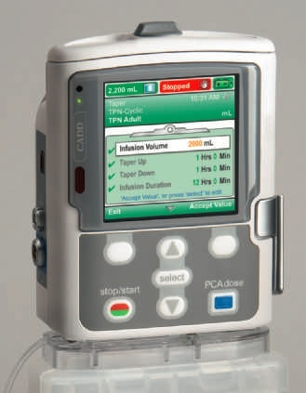

What you need to know about your IV and Infusion Pump

Slide 3

Welcome

Slide 4
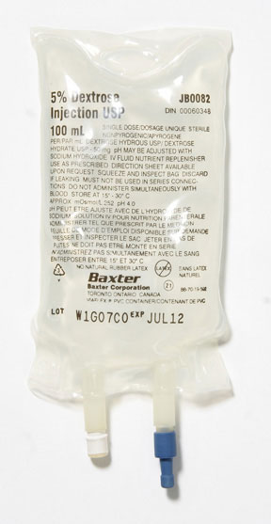
Your 24 hour medication bag will look similar to this
24 hours of medication
Pump will automatically give each dose as prescribed
Pump will be programmed by your nurse

Slide 5
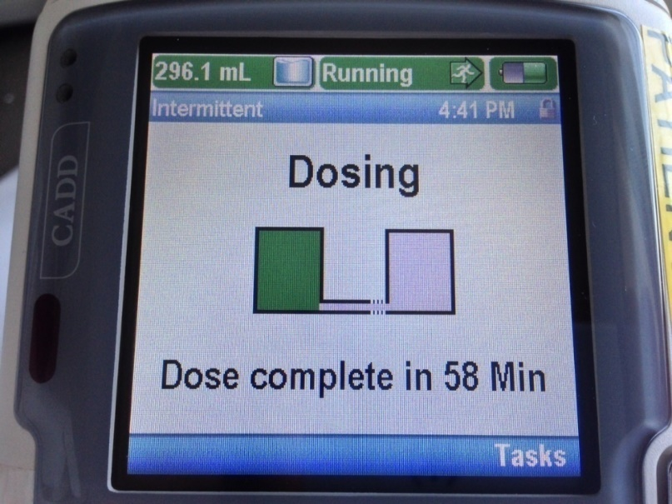
You know the pump is working when…
Green light is flashing
Status bar is green and indicates “Running”
Volume will decrease as pump gives medication

Slide 6
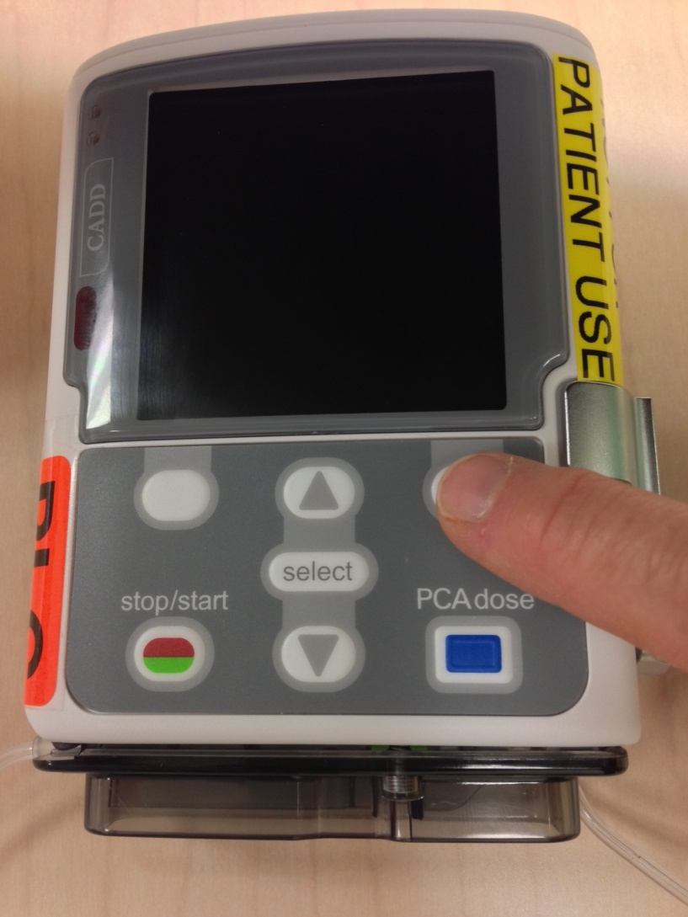
Power Saving Mode
The screen is blank when in power saving mode.
Press one of the white keys to display screen
Green light will continue to flash to show pump is working

Slide 7
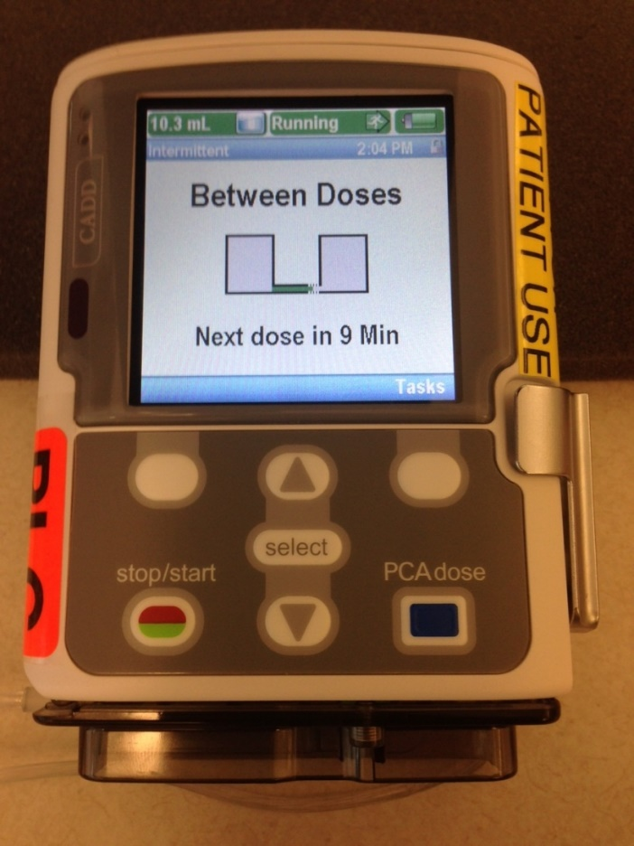
Keep pump running at all times
Until bag needs to be changed
Until you are seen in HPTP for reassessment
Unless you have a problem with the pump or your IV

Slide 8
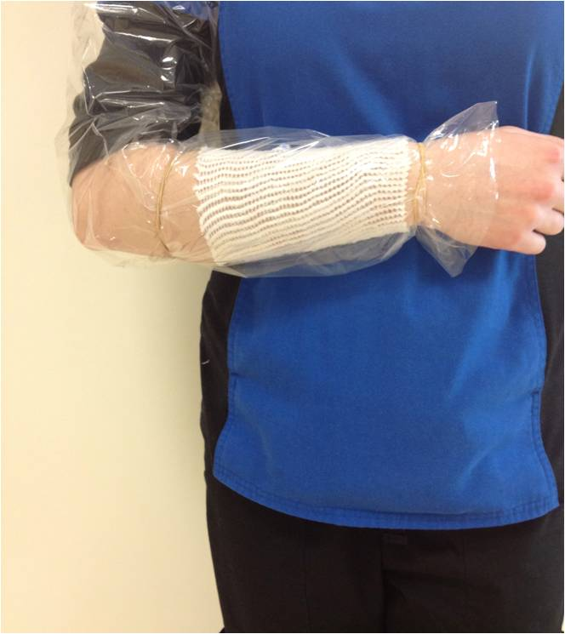
Shower or Bath

Slide 9
Sleeping with your IV

Slide 10
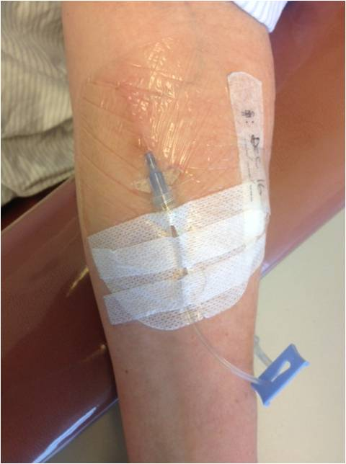
Monitor your IV site often
Red
Painful
Leaking
Swelling
If pump is not working properly

Slide 11

Who to call:
Before 9:00pm see “Contacts” section of your booklet for how to call nurse oncall

Slide 12
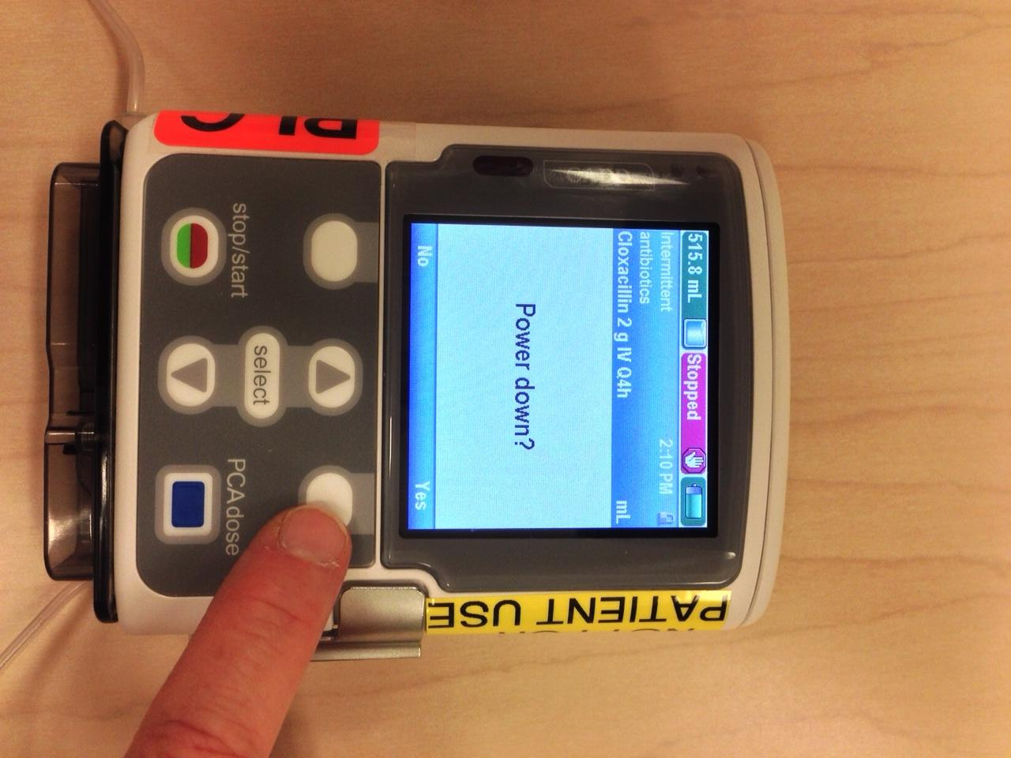
Who to call after 9:00 pm:
If unable to solve IV or pump problem: - Turn pump off - Keep tubing connected to IV and pump

Slide 13
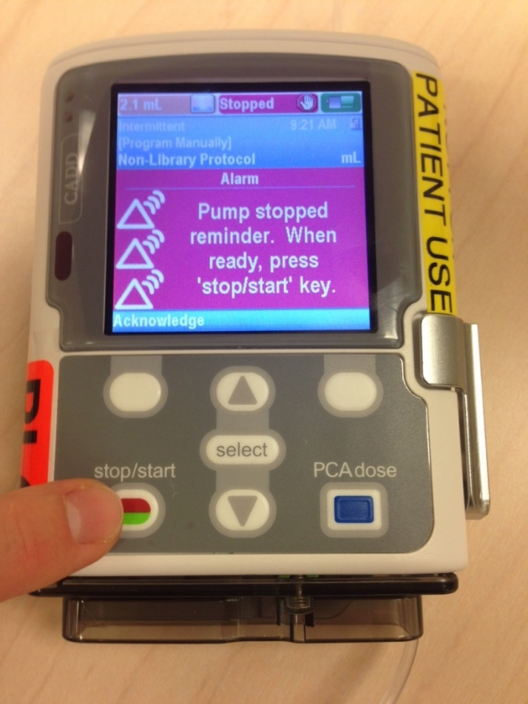
How to re-start your pump
Follow directions in your booklet
Turn your pump on
Wait for self-test and 6 beeps
Follow directions displayed on screen

Slide 14
Troubleshooting
Screen Display | What to Do
Low Batteries or Batteries Depleted Pump detects drop in battery power. | Press Stop/Start Stop Pump? choose Yes. Open the battery compartment at the top of pump and replace the 4 double AA batteries. Press the power switch to turn the pump back on. Press Stop/Start Start Pump? choose Yes.

Slide 15
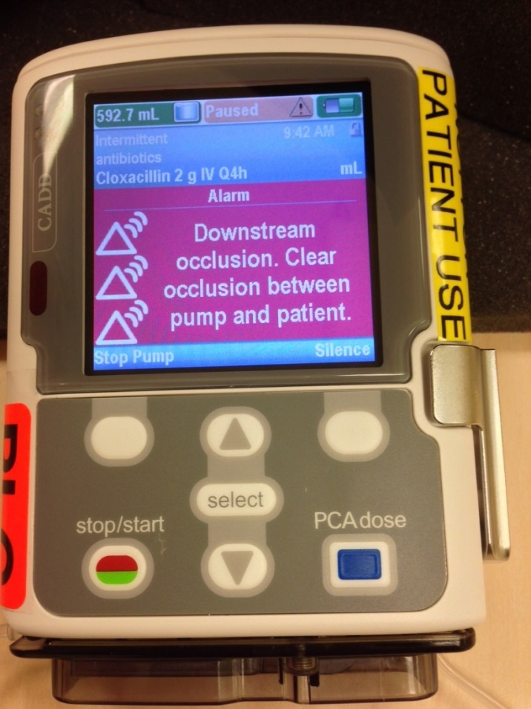
Downstream Occlusion
There is a blockage between pump and IV site
Follow instructions in troubleshooting section of booklet

Slide 16
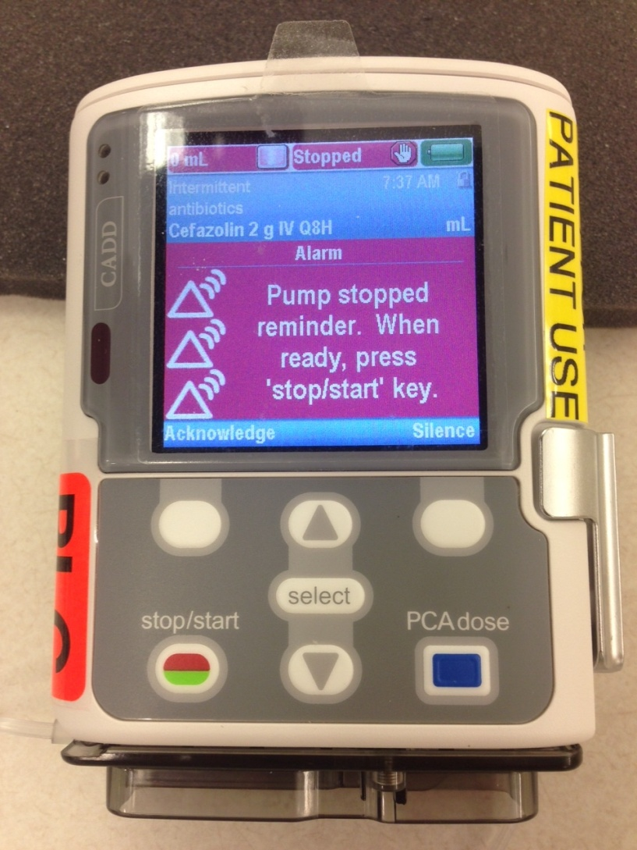
Forgot to start your pump?
If pump has been stopped
Press “silence” key
Press “stop/start” key
Follow instructions in troubleshooting section of booklet

Slide 17
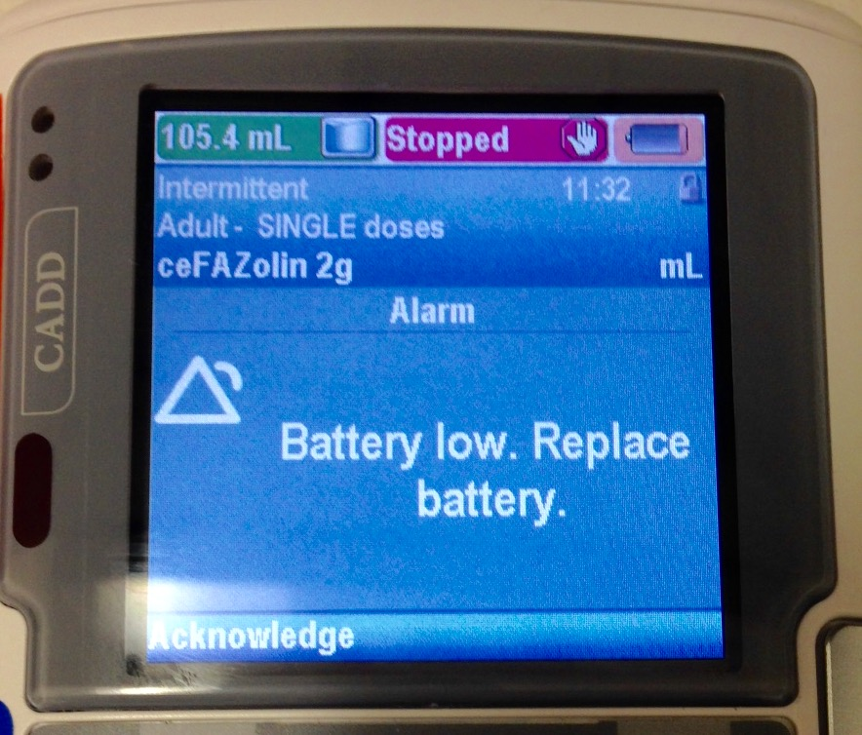
Low Batteries
Change batteries if pump alarms “low batteries”
Follow instructions in troubleshooting section of booklet
Note orange colour around grey battery icon for low battery

Slide 18
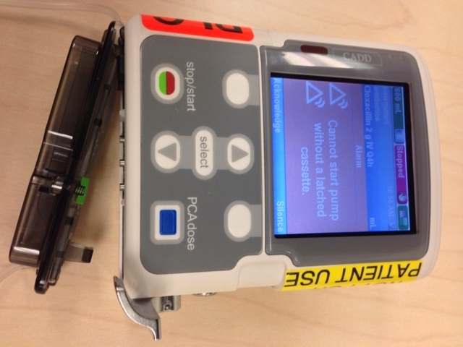
Cassette Detached
Silence alarm
Follow Help screens
Call nurse if problem persists
See troubleshooting section in booklet

Slide 19
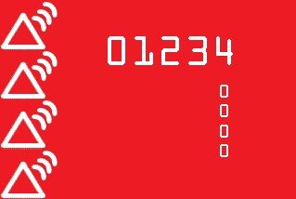
Pump Fault
System Fault Alarm
Open and close battery compartment
Turn pump back on
Call your nurse if alarm persists

Slide 20
Changing your IV bag

Slide 21
Lastly...
Ensure you are comfortable with your pump
Make a follow-up appointment
See the pharmacist before you leave
The nurse will answer any questions you have

